Slide 1
Preventing Disaster: How to Avoid Common IT Project Management Pitfalls
Providge Consulting, LLC
September 23, 2015
www.Providge.COM

Slide 2
Agenda
Welcome: why this topic is important to organizations
Introductions
Common Pitfalls of IT Project Management
Causes
Mitigating Tactics
Questions?
Twitter: @Providge
#ITPMPitfalls

Slide 3
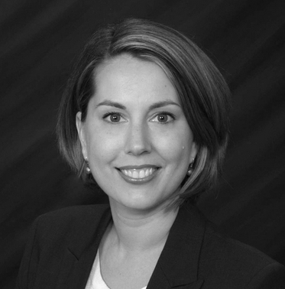
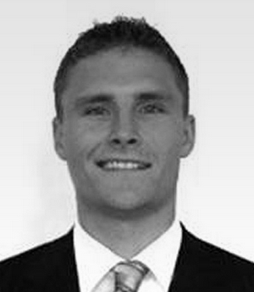
Speakers
Tara Teaford is a Managing Director at Providge Consulting. Tara has an MBA in Economics and is a PMP® certified project manager with over 15 years of experience managing complex projects. She has experience managing projects of various scope in the healthcare, retail, and hospitality industries. Tara's two must-have project management tools are a project charter and a RAID log.
Chris Weakley is a Senior Consultant at Providge Consulting. He is a certified PMP and certified Scrum Master. Chris has extensive experience global program and project management, enterprise software development and deployment and agile software development. Chris is a big-believer in limiting scope creep on projects to prevent derailment.

Slide 4
Common Pitfalls of IT Projects
Why IT Projects Fail by Taimour Al Neimat
Poor planning
Unclear goals and objectives
Objectives changing during the project
Unrealistic time or resource estimates
Lack of executive support and user involvement
Failure to communicate and act as a team
Inappropriate skills
Two themes:
Unclear End State
Tire Swing
Failure to Manage Scope and Resources

Slide 5
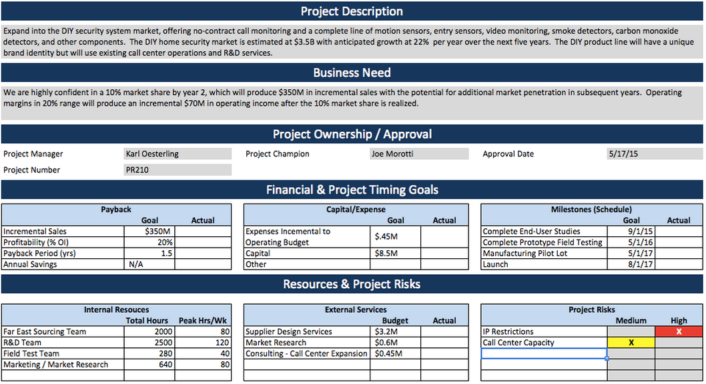
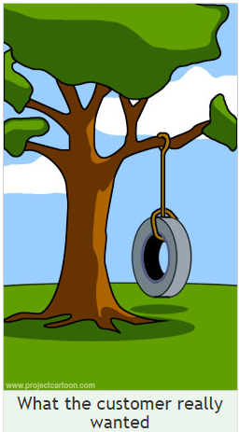
Mitigating Strategies and Tactics (PPPPP)
Know where you are going
Create a solid project charter
WHAT are you doing?
WHEN does it need to be finished?
WHO is involved? (Stakeholders)
Sponsor
Team/Resourcing
Users
WHY are we doing this?
Real world example

Slide 6
Mitigating Strategies and Tactics (PPPPP)
Effectively manage scope and resources (Limit scope creep)
Resource right.
Accountable, authorized PM to drive progress
3 great resources > 10 poor resources
Communicate, communicate, communicate.

Slide 7
Mitigating Strategies and Tactics (PPPPP)
Communicate, communicate, communicate!
Maintain artifacts in a central location accessible by all stakeholders.
Charter
RAID Log
Status Summaries
Item # | Item Type | Item Title | Details | Owner | Due Date
1 | Risk | Funding may not be available for phase 2. | Finance indicates a reduced spend for next FY. | J. Smith | Oct. 1, 2015
2 | Action | Onboard new developer. | Interviews ongoing. | L. Worth | Sep. 25, 2015
3 | Issue | Bug preventing major functionality. | See Ticket # RI89135 | T. LeMans | Sep. 25, 2015
4 | Decision | Select analytics platform | Proposals available from 3 vendors; under review. | M. Michaels | Jan. 2, 2016

Slide 8
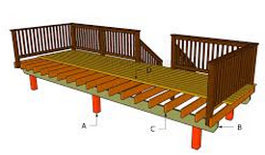
Scope Management
Scope creep defined: uncontrolled change of a project’s goals…
80% of projects experience scope creep
Risk of unexpected cost and timeline increases
Risk of a divergence in expected project outcomes
Mitigating Strategies
Clarify and communicate project scope
Plan for and communicate scope management strategy
Evaluate proposed changes for value and impact
Adjust scope intelligently, adjust plan when needed
Communicate!

Slide 9
Scope Creep Mitigation
Clarify and Communicate Scope
What is our vision and our end-goals? What are our constraints?
Who is benefitting and why? How can we best provide that benefit?
Manage Scope
Embrace inevitable change
Define a clear path to change
Evaluate Changes
What value is the change providing? Is it in line with our vision?
What is the impact on the project to incorporate the change
Adjust scope
Re-clarify and communicate scope
Adjust project as needed

Slide 10
Questions?
Tara Teaford is a Managing Director at Providge Consulting. Tara has an MBA in Economics and is a PMP® certified project manager with over 15 years of experience managing complex projects. She has experience managing projects of various scope in the healthcare, retail, and hospitality industries. Tara's two must-have project management tools are a project charter and a RAID log.
Chris Weakley is a Senior Consultant at Providge Consulting. He is a certified PMP and certified Scrum Master. Chris has extensive experience global program and project management, enterprise software development and deployment and agile software development. Chris is a big-believer in limiting scope creep on projects to prevent derailment.
Twitter: @Providge
#ITPMPitfalls

